Slide 1
Introduction to Aspect Oriented Programming
Life is found in layers
Notes:
last update: 4/3/2013

Slide 2
Single Responsibility Principle
Every class should have responsibility over a single piece of functionality provided.
That responsibility should be entirely encapsulated by the class. All its services should be narrowly aligned with that responsibility.
A class should have only one reason to change.
Notes:
DI; Separation of concerns…scalable testable
https://hackernoon.com/you-dont-understand-the-single-responsibility-principle-abfdd005b137
Limit the impact of change

Slide 3
The General AOP Use Case:
Scattering & Tangling
A functional implementation is scattered if its code is spread out over multiple modules. Its implementation is not modular. A small change in functionality needs to be made in multiple modules.
Logging is “scattered” throughout an application
Example:
Adding/removing/modifying a logging message that spans ALL service methods
See AOP Demo
A functional implementation is tangled if its code is intermixed with code that implements other functionality. The module in which tangling occurs is not cohesive.
[Programmatic] Transaction Management is “tangled” within a method
See Lesson 2 HibernateSolo Demo
Aspect-oriented approach identifies code scattering and tangling as the indicators of crosscutting concerns.
Notes:
Performance: long startTime = System.currentTimeMillis(); -- at start of method
long elapsedTime = System.currentTimeMillis() - startTime; -- at end of method

Slide 4
AOP Value Added
Separation of Concerns
Increased Modularity
Reduces “spaghetti” code
Code reduction
Removes “hard” dependencies
Some USE CASES:
Boilerplate/repetitive code – unable to be refactored using normal OO techniques
Transaction
Security
Logging
Authorization
Validation

Slide 5
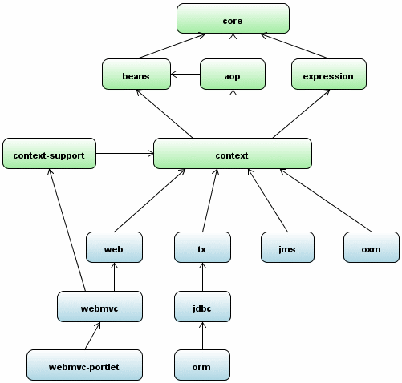
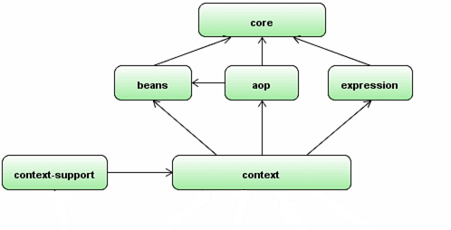
AOP - a Spring Core Technology
One of the key components of Spring is the AOP framework. While the Spring IoC container does not depend on AOP, meaning you do not need to use AOP if you don’t want to, AOP complements Spring IoC to provide a very capable middleware solution.
The Spring Framework uses Spring AOP internally for transaction management, security, remote access, and Cache Abstraction.
Spring Core & Dependencies
Notes:
OXM Object to XML mapping

Slide 6
AOP Definitions
Cross-cutting Concern
Another name for an Aspect.
An Aspect “crosscuts” core functionality
Aspect
Functionality fundamental to application
BUT not the primary business function.
Aspect is to AOP as Class is to OOP.
Notes:
, violates Separation of Concerns [ unless “isolated” ] ??

Slide 7
AOP Definitions [Cont.]
Aspect - implemented by applying Advice (additional behavior) at various Join points (methods in Spring application) specified by a Pointcut (criteria to match Join points to Advice).
Advice
Implementation code of the aspect.
[executed Around, Before or After Join point]
[ Associated with Join Point through a Pointcut]
Join point
Where Advice code in applied in application
[Always class methods in Spring AOP]
Pointcut
An expression that defines a set of Join points

Slide 8
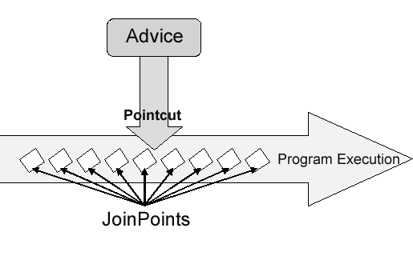
AOP Terminology Relationships
Aspect = Advice + Pointcut
@Aspect
public class LoggingAspect {
@Before ("execution(* edu.mum.service..*(..))")
public void logIt(JoinPoint joinPoint) {
Defines Class as Aspect
Advice – ‘When” to apply crosscutting function
Pointcut – Defines the JoinPoints
[ Methods in the application] to apply crosscutting function to.
Advice - Method
The Crosscutting Function

Slide 9
Main Point
Aspect Oriented Programming allows us to consolidate in one place the repetitive code that is scattered throughout an application, increasing the maintainability and clarity of the logic.
Science of Consciousness: Refining the function of the nervous system leads to improvement in physical health and mental clarity

Slide 10
Static & Dynamic AOP in Spring
Static [AspectJ]
Cross-cutting logic is applied at compile time
Byte code modification [ better performance]
Aspect can be applied to fields [more join points]
Any Java code
Dynamic [Spring AOP]
Cross-cutting logic applied at run time
Proxy based approach [simple to use]
Aspects applied to methods only
Spring Managed beans
NOTE: @AspectJ is a subset of AspectJ that declares AOP annotations. We will use this subset with Spring AOP without FULL AspectJ implementation
Notes:
Spring AOP It is not for advising fine-grained objects (or domain objects)—it is best suitable for coarse-grained objects due to performance.

Slide 11
Spring AOP - PROXY
JDK Dynamic Proxies
Interface-based proxy
Recommended choice [ Spring IS interface based]
CGLib [(Byte) Code Generation Library)]
Use if Concrete Classes need proxy
Generated subclass used as proxy
Notes:
Concrete class DEFEATS the purpose of DI
IF ONE interface is defined a class then SPRING will use PROXY
https://docs.spring.io/spring/docs/2.5.x/reference/aop.html#aop-proxying

Slide 12
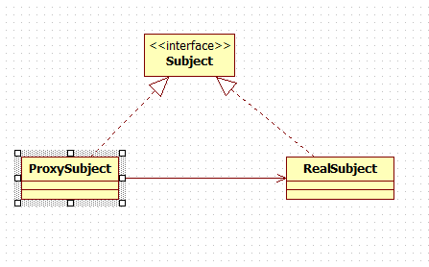
Spring AOP - Proxy Pattern
Subject - Interface implemented by the RealSubject
Proxy - Controls access to the RealSubject
RealSubject - the real object that the proxy represents.

Slide 13
Spring AOP Method Level Proxy
“gotcha”
Local or internal method calls within an advised class don’t get intercepted by proxy, so advice method of the aspect does not get fired/invoked
Public class Order
@Logging
public Order update(Order order) {
this.updateAdjunct();
return orderDao.update(order);
}
// This Never gets logged when called from update -
// BECAUSE of Method level proxy "gotcha"
@Logging
public void updateAdjunct() {
return ;
Notes:
Once passed into the target proxy; you are in the instance – so this.foo() will be a local [instance] call
DOES NOT got through target class
With THIS:
<aop:aspectj-autoproxy expose-proxy="true"/>
You can, in your target code, reroute self-invocating methods back through the target proxy.

Slide 14
ADVICE TYPES
ADVICE | DESCRIPTION
@Before | executes before a join point
@AfterReturning | Executes if a join point completes normally
AfterThrowing | executes if a join point throws an exception
@After | executes if a join point executes normally OR throws an exception
@Around | Before AND after the join point. Also can end execution or throw exception
See AOP Advice Types

Slide 15
Point Cut Designators [PCD]
POINTCUT | DESCRIPTION | SYNTAX
execution | Matches methods Including visibility,return & parameters | ("execution(public * *.*.*(..))")
within | Matches join points within “range” of types[Class] | (“within(*.*.*.*)")
target | Matches where the target object is an instance of the given specific type [Class] | (“target(pkg.pkg.pkg.class)")
args | Matches where the arguments are instances of the given types [Plus binding function] | (“args(..)")
@annotation | Matches methods where the given annotation exists | @annotation(anotationName)
WITHIN only class
So no visibiliyt;return value;method or params
TARGET only SPECIFIC class
ALL impl ANYWHERE
Supported Pointcuts
Notes:
http://www.baeldung.com/spring-aop-pointcut-tutorial
https://guptavikas.wordpress.com/2010/04/15/aspectj-pointcut-expressions/
http://blog.espenberntsen.net/2010/03/20/aspectj-cheat-sheet/

Slide 16
PCD Examples
Implicit – PCD expression inside the Advice annotation
Match all Classes; all methods in package impl that are public AND have a void return value
@Before("execution( public void edu.mum.service.impl.*(..))")
Match All Classes & methods]in package service & ALL subpackages
@Before(“within(edu.mum.service..*)")
Match all instances of OrderService
@Before(“target(edu.mum.service.OrderService)")
Match all methods with a signature of Integer,Product followed by zero or more args
@Before(“args(Integer,edu.mum.domain.Product,..)")
The .* matches zero or more characters terminates match with NEXT ‘.’
Spring AOP recognizes PUBLIC only
The (..) pattern matches any number of parameters (zero or more).
Must specify “specific” Class
Notice path to Class
Notes:
AND binds the Integer & Product to the Advice
@Before(“args(counter,product,..)")
public void testExecution(Integer counter, Product product) {
“this” is for NON INTERFACE objects
if FooDao doesn’t implement any interface or proxyTargetClass property is set to true then the proxied object will be a subclass of FooDao and the this PCD could be used: @Pointcut("this(org.baeldung.dao.FooDao)")
Due to the proxy-based nature of Spring's AOP framework, protected methods are by definition not intercepted, neither for JDK proxies (where this isn't applicable) nor for CGLIB proxies (where this is technically possible but not recommendable for AOP purposes). As a consequence, any given pointcut will be matched against public methods only!
If your interception needs include protected/private methods or even constructors, consider the use of Spring-driven native AspectJ weaving instead of Spring's proxy-based AOP framework. This constitutes a different mode of AOP usage with different characteristics, so be sure to make yourself familiar with weaving first before making a decision.

Slide 17
More on args() Pointcut
@Before("execution(* edu.mum.service.impl.*(Integer))")
is the same as
@Before("execution(* edu.mum.service.impl.*(..)) && args(Integer)")
public void testExecution()
However
The args pointcut also provides the “option” of binding the parameters to the Advice method.
It does so by declaring the instance name versus the instance type:
@Before(“args(counter)")
public void testExecution(Integer counter) {
On the otherhand this will result in an Exception:
@Before(“args(Integer)")
public void testExecution(Integer counter)
Because you declared “binding param” in Advice

Slide 18
Explicit Pointcut Declaration
@Pointcut("execution(* edu.mum..*(..))")
public void applicationMethod() {}
@Pointcut("@annotation(edu.mum.aspect.annotation.Logging)")
public void logging() {}
@Before("logging() && applicationMethod()")
public void logIt(JoinPoint joinPoint) {
Explicit Pointcuts are invoked based on the pointcut method signature.
They can be logically combined with the following logical operators:
and [&&] or [||] not [!]
The operators can be either symbols or text

Slide 19
Pointcut & Advice Method Signatures
Advice Method Parameters
Any advice method MAY declare as its first parameter, a parameter of type org.aspectj.lang.JoinPoint [AKA advice method – can “introspect”]
@Before("logging() && applicationMethod()")
public void logIt(JoinPoint joinPoint) {
Instance names declared in an (“args(..)") expression will be passed to the advice method [for binding]
@Before(“args(num,productAdd, name)")
public void method(Integer num,Product productAdd,String name)
Instance names can also be declared in an explicitly defined Pointcut
@Pointcut(“args(name,count)")
public void applicationMethod(String name, Integer count)
Instance names as parameters are placeholders where the instance type is defined in the method Signature…
It will bind the parameter to the Advice
when it is applied
Notes:
ARGS make argument values available to the advice body …The argument passed to that parameter is an instance of Object so product vs Product

Slide 20
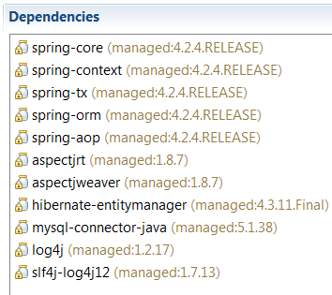
Configure Spring AOP
pom.xml dependencies:
applicatonContext.xml
xmlns:aop="http://www.springframework.org/schema/aop"
http://www.springframework.org/schema/aop
http://www.springframework.org/schema/aop/spring-aop.xsd ">
THIS results in the creation of Spring AOP proxies.
<aop:aspectj-autoproxy />
See AOP Demo
References AOP namespace to
Activate AspectJ annotations

Slide 21
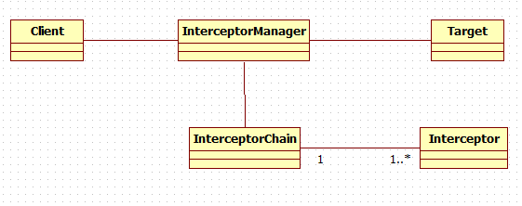
Interceptor Chain
Core J2EE Pattern - Intercepting Filter
Spring AOP models an aspect as an interceptor, maintaining a chain of interceptors "around" a join point
Annotation based ordering is implemented with the @Order annotation
@Aspect
@Order(1)
public class LoggingAspect {
default is Ordered.LOWEST_PRECEDENCE. = 2147483647
On the way in to a joinpoint, the aspect with lowest Order value gets executed first.
On the way out from the joinpoint, the aspect with highest Order value gets executed first.
Notes:
User defined AOP – precedence is “undefined”
<tx:annotation-driven order="100"/>
Default : Ordered.LOWEST_PRECEDENCE
<security:global-method-security/> The default is Ordered.LOWEST_PRECEDENCE. = 2147483647

Slide 22
Spring Declarative
Transaction Management
An AOP Example
Spring Transaction Management is based on Spring AOP
Declarative Transaction Management allows for:
Customized Transactional Behavior [through AOP]
Insert custom behavior in the case of transaction rollback.
Add custom advice along with the transactional advice.
Notes:
<bean id="txManager" class="org.springframework.transaction.jta.JtaTransactionManager" />
<bean id="txManager" class="org.springframework.orm.hibernate3.HibernateTransactionManager"> <property name="sessionFactory" ref="sessionFactory" /> </bean>
http://docs.spring.io/autorepo/docs/spring/4.2.x/spring-framework-reference/html/transaction.html

Slide 23
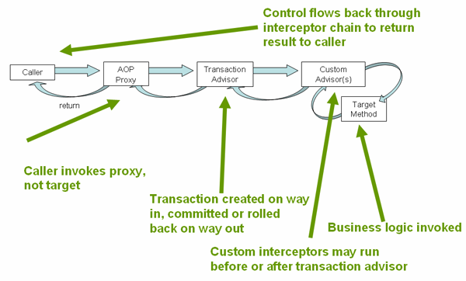
Spring Transaction - AOP-based
Spring Framework’s declarative transaction support is based on Spring AOP Transactional advice is driven by metadata (XML- or annotation-based)
Let’s examine a XML metadata example to see the AOP configuration…
Notes:
Advisor is Pointcut PLUS advice OLD SCHOOL
Java annotations are not inherited from interfaces means that if you are using class-based proxies
So DO NOT put @Transactional on an interface!!!
The combination of AOP with transactional metadata yields an AOP proxy that uses a TransactionInterceptor in conjunction with an appropriate PlatformTransactionManager implementation to drive transactions around method invocations.

Slide 24
Declarative AOP XML based
XML-Based Transaction declaration [ .vs. @Transactional ]
In applicationContext.xml:
Advisor - Associate pointcut with Advice
<aop:config>
<aop:advisor pointcut="within(edu.mum.service.impl.*)"
advice-ref="transactionAdvice" order="200" />
</aop:config>
<tx:advice id="transactionAdvice" transaction-manager="transactionManager">
<tx:attributes>
<tx:method name="*" propagation="REQUIRED“
rollback-for="java.lang.Exception" />
</tx:attributes>
</tx:advice>
Interceptor chain order
Notes:
On the way in to a joinpoint, the advice with lowest Order value gets executed first.
On the way out from the joinpoint, the advice with highest Order value gets executed first.
public class PerformanceLoggingAdvice implements MethodBeforeAdvice, AfterReturningAdvice {

Slide 25
Downside to AOP
Functionality gets fragmented across source files and hard to understand.
You don’t have a clear overview of what code runs when
Problematic to debug the AOP based application code.
Code Inspection and reviews are challenging
AOP can be too complex for application in the Enterprise
There are only a handful of cross-cutting concerns
It can be “over-used”
A Little Bit of Aspect-Oriented Programming Is Just Enough
- The Gartner Reports

Slide 26
Main Point
AOP applied judiciously can make an application more efficient and effective.
Science of Consciousness: Regular practice of the TM technique makes an individual more efficient and effective.

